Slide 1
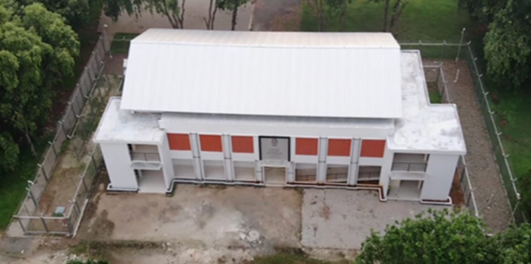
RSG G. A. Siwabessy Security System Overview: Response A special training on Sabotage Mitigation Dany Mulyana, PhD
National Nuclear Security Administration of U.S. Department of Energy
Indonesian Research and Innovation Agency
Serpong, Indonesia, May 5th, 2025

Slide 2
Physical Protection System Scope
Protection of:
Nuclear material,
Radioactive material, and/or
Nuclear facilities
Against the threat of:
Theft/removal,
Sabotage, and/or
Unauthorized transfer

Slide 3
Legal Framework
Nuclear Act
No.10 / 1997
Nuclear Power
Government Regulations
No. 54 / 2012
Safety and security of Nuclear Facilities
BAPETEN Regulations
No. 1 / 2009
Physical Protection System of Nuclear Material and Nuclear Facilities
BAPETEN Regulations
No. 6 / 2015
Security of Radioactive Source
Government Regulations
No 02 / 2014
Nuclear Reactor License

Slide 4
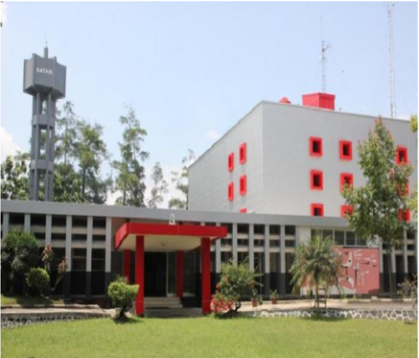
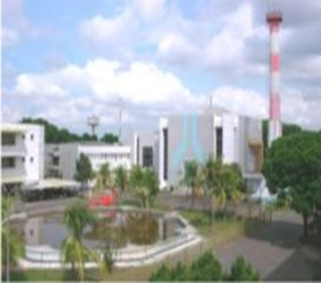
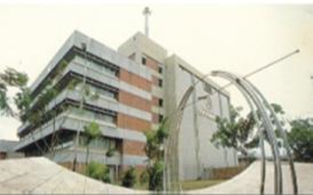
BRIN’s Nuclear Facilities
Located at Bandung
Operated on 1964
Power 250 Kw
Upgrade 1000Kw / 1971
Upgrade 2000 Kw / 2000
Category III
Located at Jogyakarta
Operated on1979
Capacity 100 Kw
Category III
Located at Serpong
Operated on 1987
Capacity 30 MW
Category II

Slide 5
Serpong Nuclear Complex
Vital Area
Protected Area
25 hectare area
FEFI
1300 Employees
Protected Area
RWI
Vital Area
EFEI
CAS
IS
RSG
RMI
RII
NSSC
TRRI
Limited Area

Slide 6
BRIN’s BJ Habibie Science & Tech Area
Deputy of Infrastructure (DIRI)
Police
Agency for Disaster Mitigation
Directorate of Sci & Tech Area
Directorate of Nuclear Facility Management
BJ Habibie Area Manager
Etc.
Nuclear Security Manager
OHSAS
Maintenance
Team
CAS
Guards
Security Manager
Guards

Slide 7
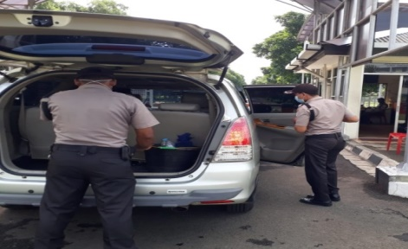
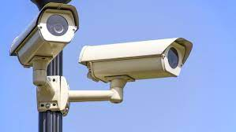
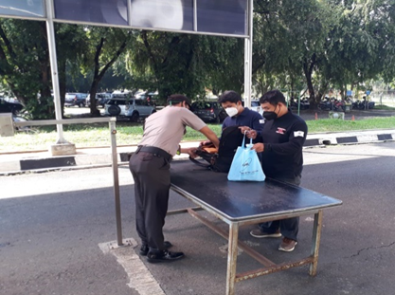
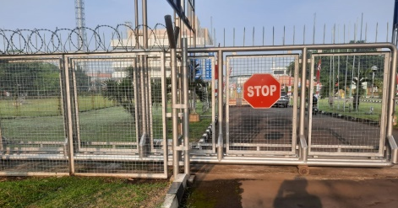
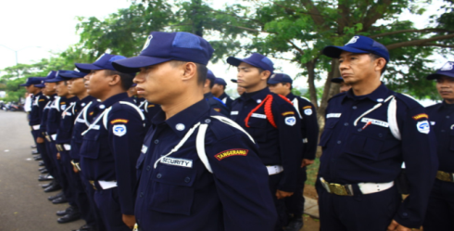
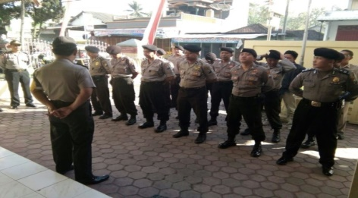
Physical Protection System
Detection
Check Motorcycle Baggage
Check Baggage Vehicle
Camera Assessment
Check Bag Personal
Check Gate - Metal Detector
Visitor Check Point
Delay
Fence
Barrier Gate
Active Barrier Gate
Response
Security Squad
Police Dept

Slide 8
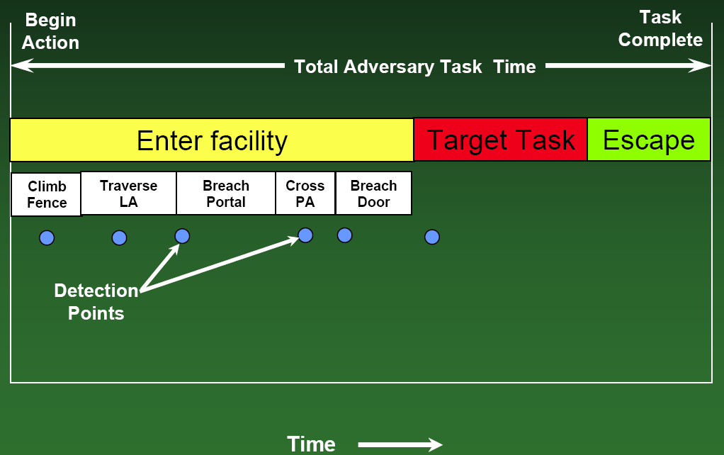
Example of an Adversary Path

Slide 9
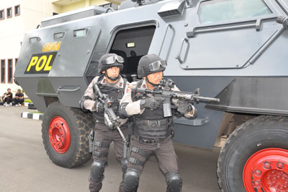

Slide 10
Response Team Functions
Interruption
Needs reliable INPUT → detection and communication
Needs a simple access
Needs proper strategies
Needs sustainable exercise
Neutralization
Needs reliable capacity
Needs sufficient equipment
Needs proper strategies
Needs sustainable exercise

Slide 11
Slow Response
Begin
Action
Task
Complete
Total Adversary Task Time
System Delay after Detection
System Response Time (RFT)
First Alarm
Detect
Alarm Assessed
Respond
Arrive too late
T₀
T_{A}
T_{C}
T_{I}
Time

Slide 12
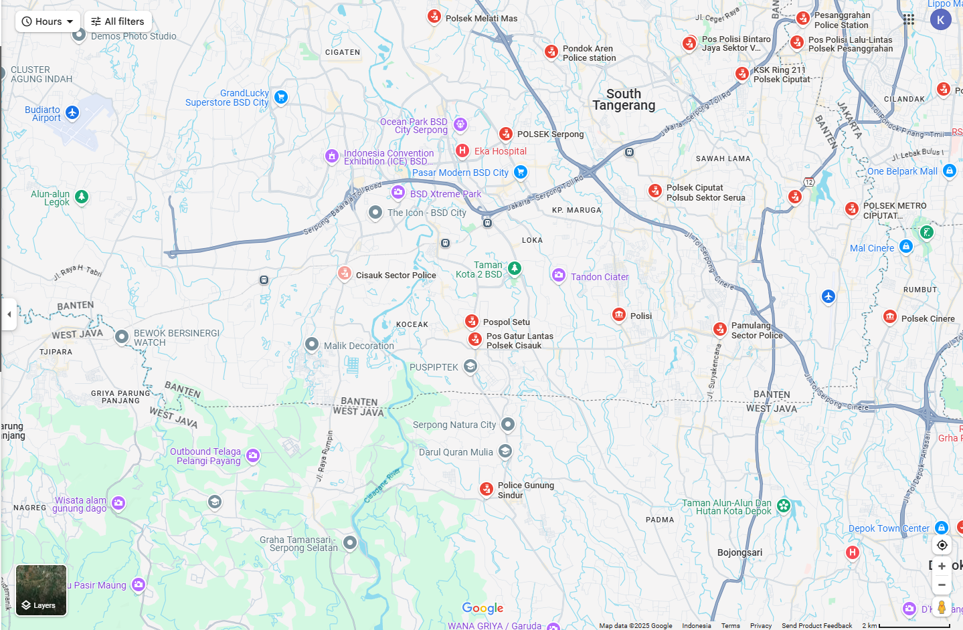
Access

Slide 13
Response Strategies
Containment
Do not let your adversary get away!
Suitable for theft scenario
Denial
Do not let your adversary touch your property using any measurable means!!
Suitable for sabotage scenario
May also automatically apply to theft scenario

Slide 14
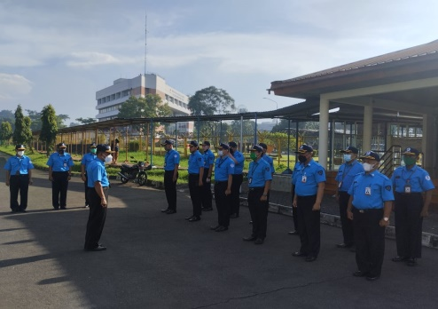
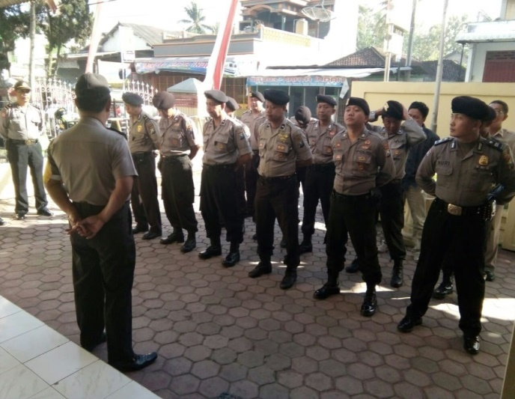
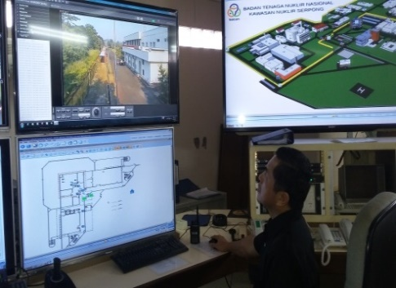
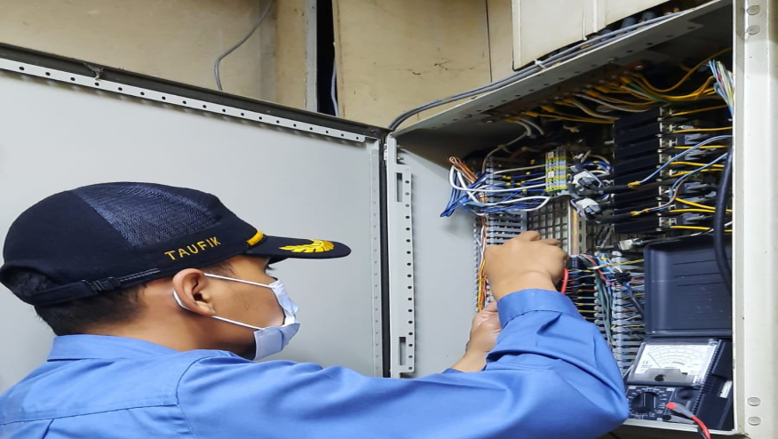
Capacity
Security Guard
Security squad
Police
Operator CAS
Maintenance of PPS

Slide 15
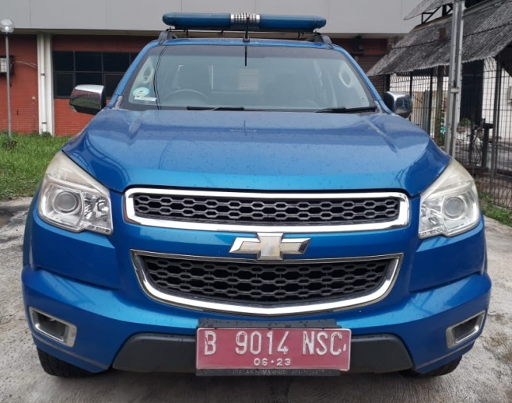
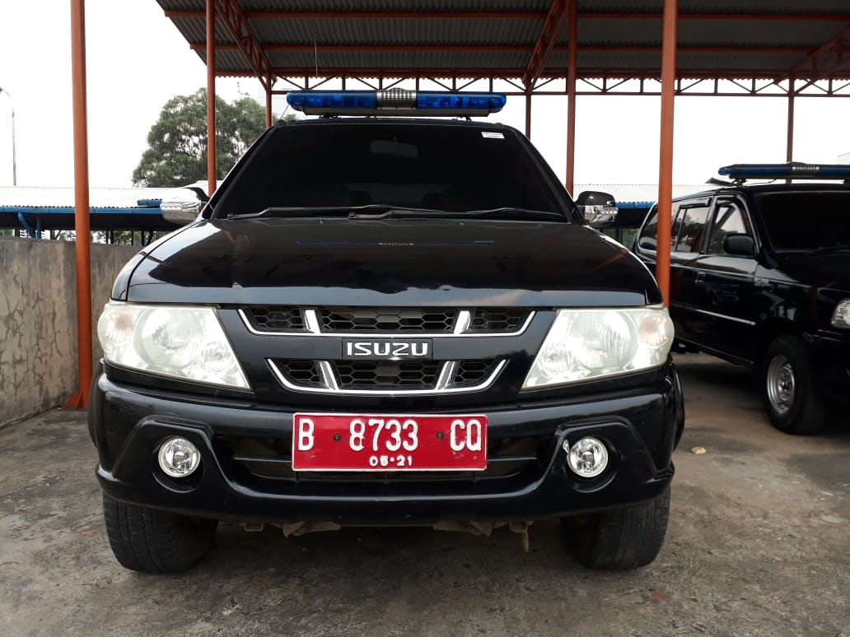
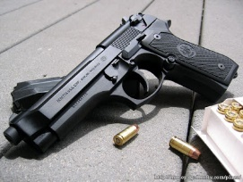
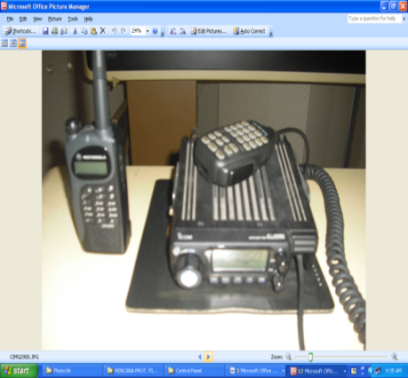
Equipment
escort vehicle
Patrol Vehicle
Patrol Motorcycle
weapon
Pistol
Body Armour
Bomb Blanket
Radio Communication

Slide 16
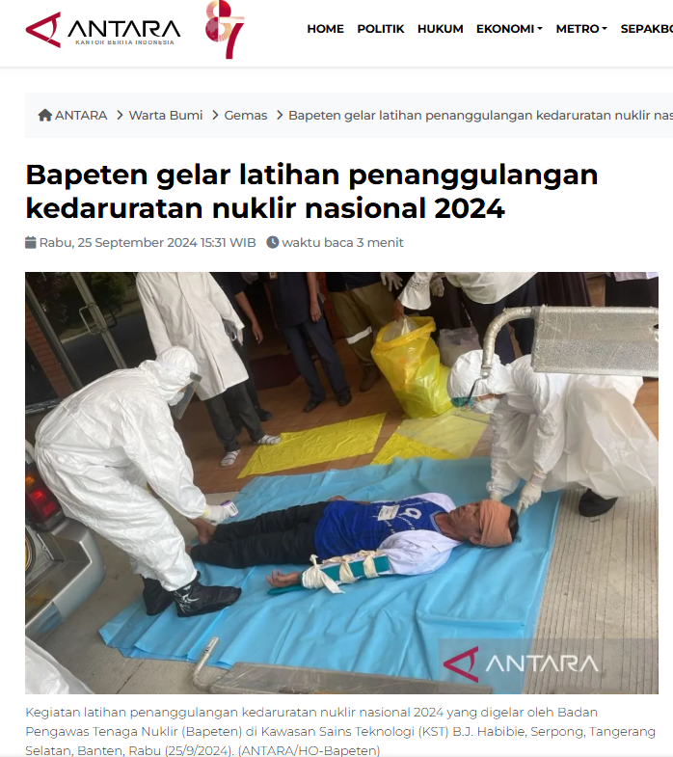
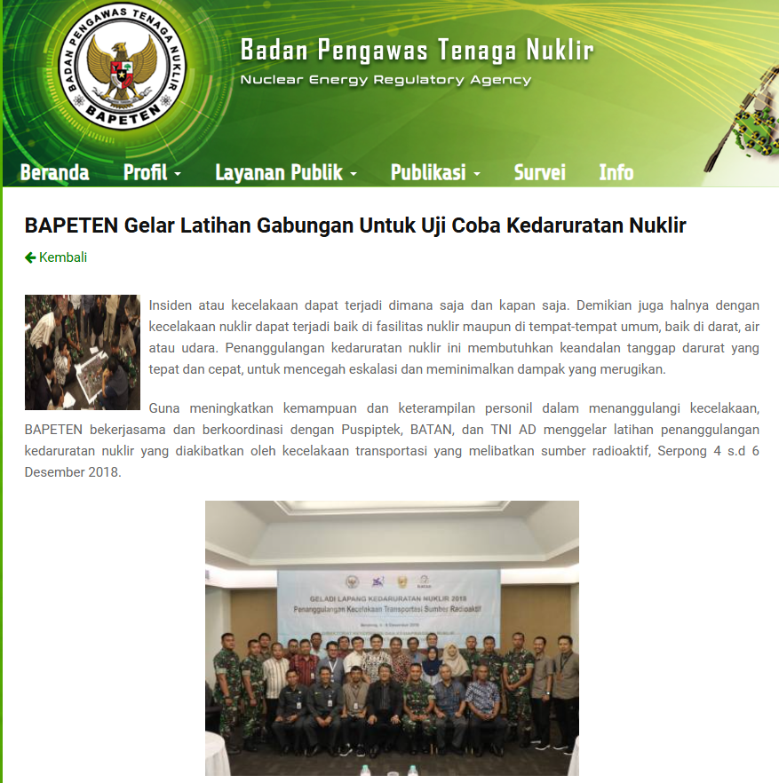

Slide 17
In-site Vs. External Response Challenges
Multiple organizations
Authorities & Responsibilities
Unbalanced Capacities
Miscommunication
Expensive trainings

Slide 18
Insider vs PPS

Slide 19
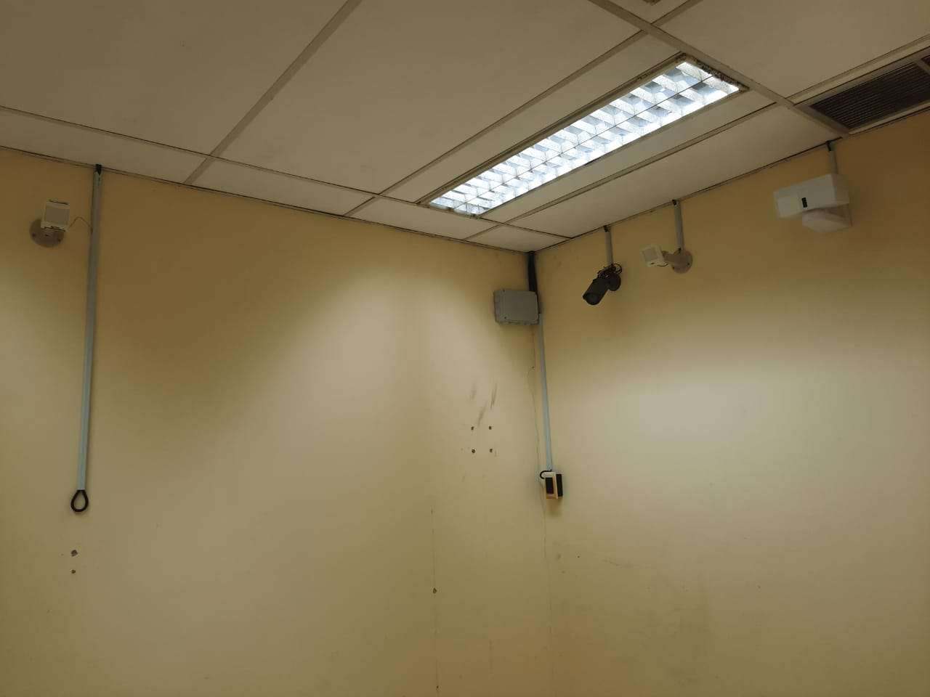
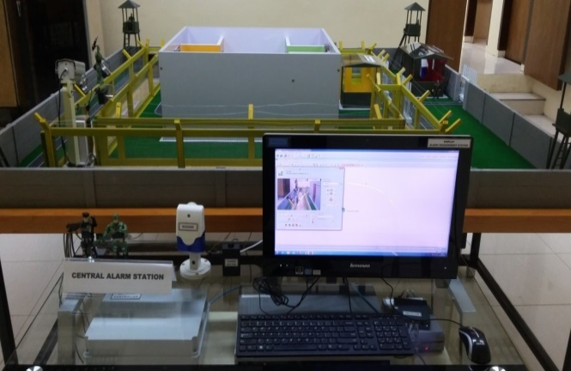
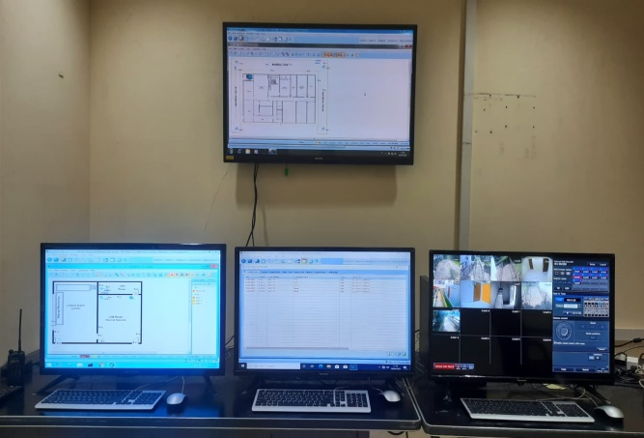
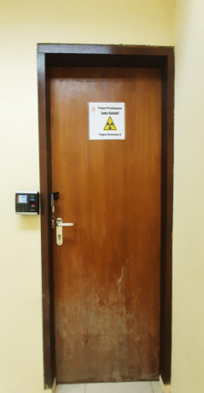
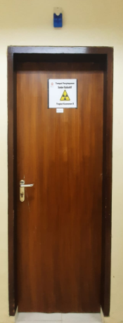
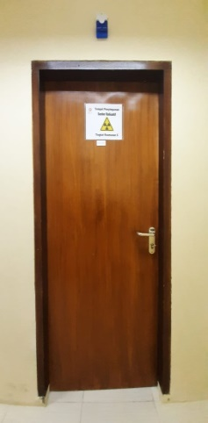
NSSC Facility
Internal Sensors
Access Control
External Sensors (PIDS)
Mockup Hypothetical Nuclear Facility
Central Alarm Station
(CAS)
Storage of Radioactive Source

Slide 20
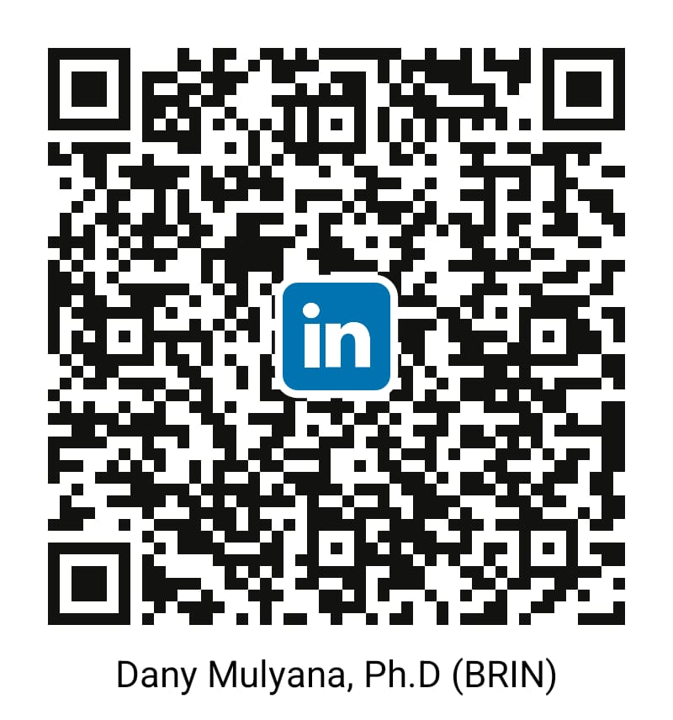
Enjoy your training!
dany002@brin.go.id

Slide 21
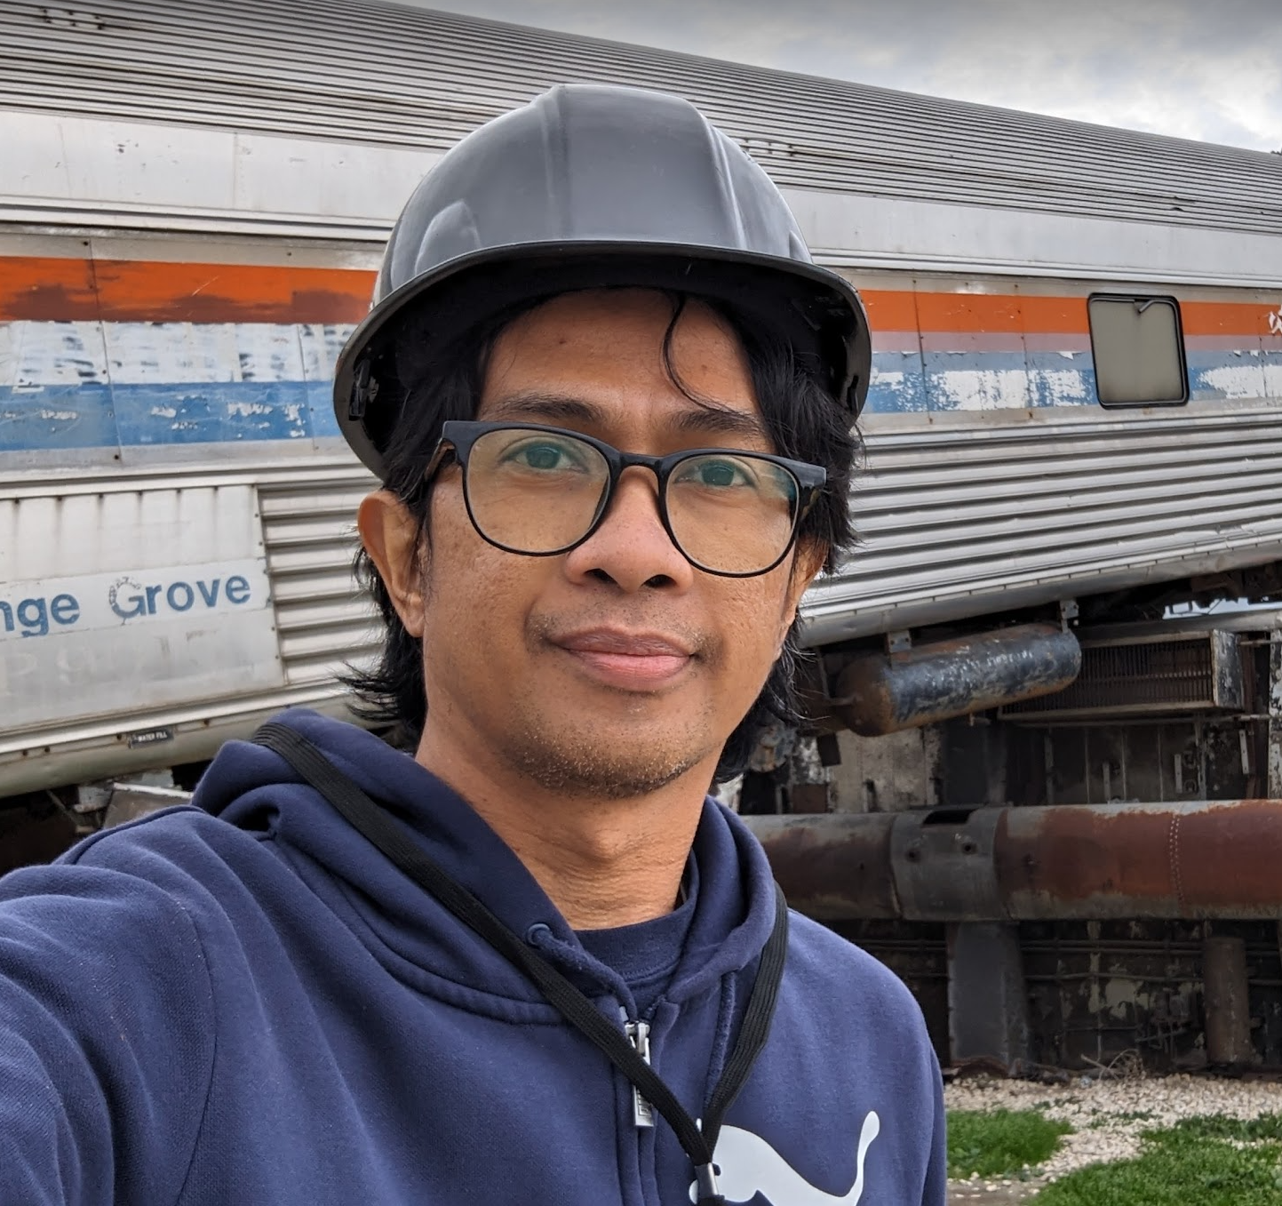
About Me
B.Sc in Physics, universitas Padjadjaran (2003)
M.Sc in Physics, Universitas Indonesia (2007)
Ph.D in Nuclear Engineering, Texas A&M University (2021)
Non-degree certificate in Nuclear Security, Texas A&M University (2014)
Nuclear Security Leadership Awardee, US Dept of State (2013-2016)
Safety & Security Standards Engineer, BATAN (2003- 2014)
Auditor, Safety & Security System BATAN (2012-2016)
Auditor, National Inspection Body, KAN (2014-2016)
Auditor, Quality & Information Security MS (2010-2016)
Developer, Nuclear Security Management System, BATAN (2014-2016)
Senior Researcher, Nuclear Security Science and Policy Institute (NSSPI), Texas A&M University (2021-2024)
Principal Physicist, National Center for Electron Beam Research, Texas A&M University (2021-2024)
Researcher, BRIN (2024 – now)
Research Group Leader, Nuclear Security and Safeguards, BRIN (2024 – now)
Chief of Research and Engineering for Advanced Reactor Development, Center For Reactor Technology, BRIN (2025 – now)

