Slide 1
Publish An Article In A Reputable International Journal
Muhammad Naufal
muha353@brin.go.id

Slide 2
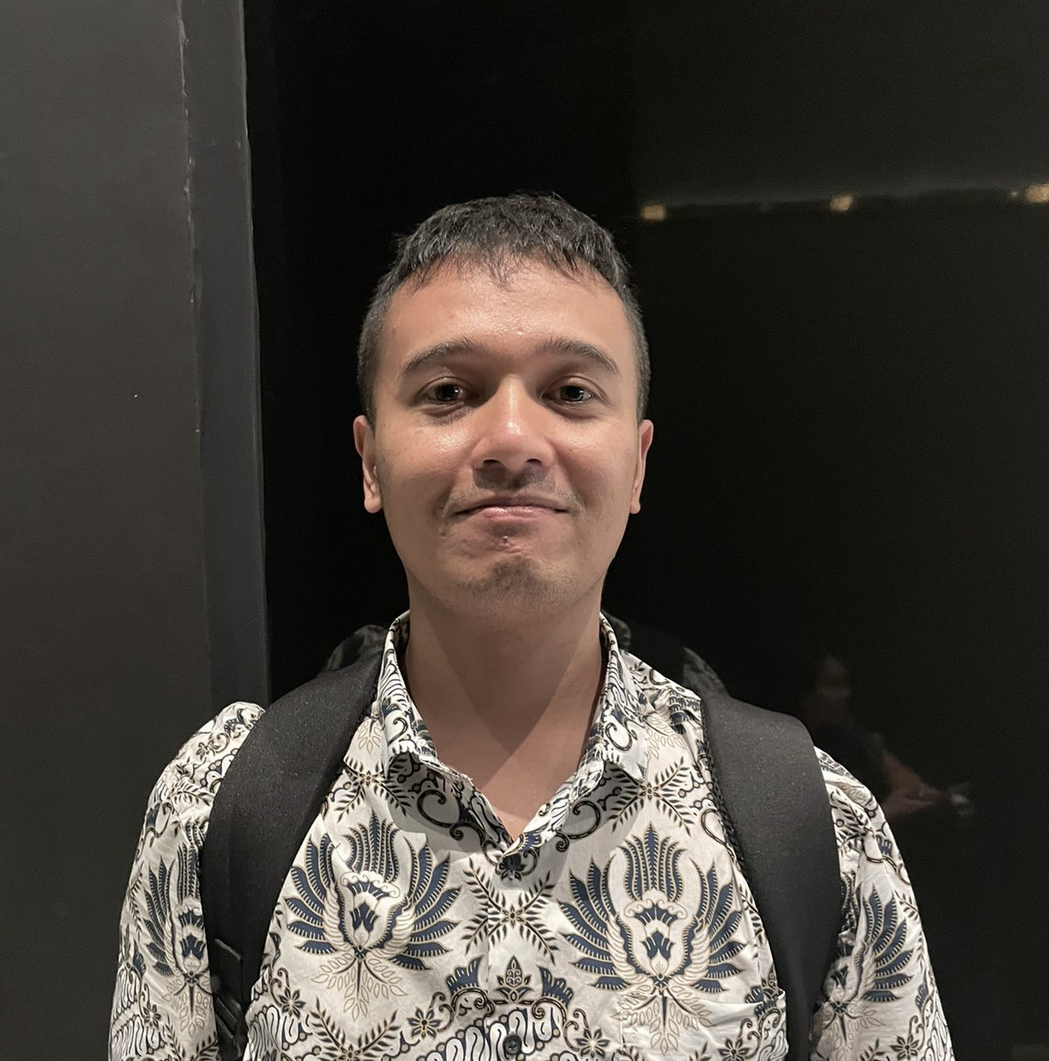
Muhammad Naufal
National Cheng Kung University – Doctor of Philosophy
Institut Teknologi Sepuluh Nopember – Master Degree
Universitas Airlangga – Bachelor Degree
Work Experience:
Post-Doctoral Fellowship in NCKU, Taiwan
Badan Riset dan Inovasi Nasional – now
muha353@brin.go.id

Slide 3
Overview
Reputable Journal
Tips/strategi Menulis Manuskrip
Checklist Sebelum Manuskrip Final
Sebelum Submit
Setelah Submit

Slide 4
Pentingnya Menerbitkan Artikel di Jurnal Berkualitas Tinggi
Meningkatkan reputasi akademik
Dapatkan pengakuan yang lebih luas
Berkontribusi pada kemajuan ilmiah
Peluang pengembangan karir

Slide 5
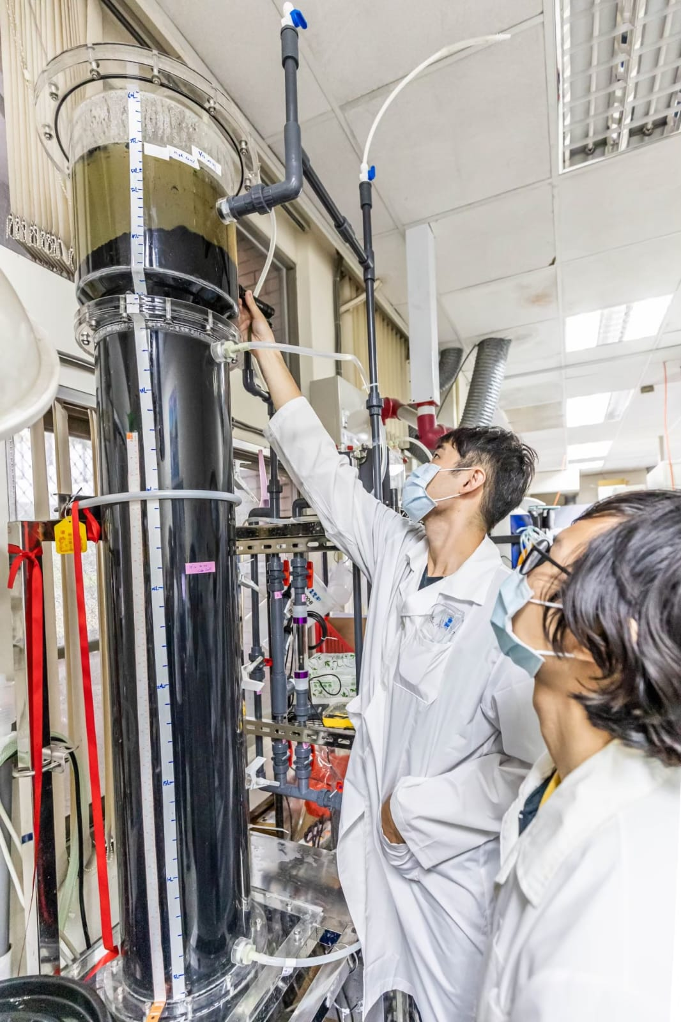
Bagaimana menemukan kebaharuan?
Mengidentifikasi kontribusi yang unik
Metodologi atau temuan inovatif
Relevansi dengan isu-isu ilmiah dan sosial saat ini

Slide 6
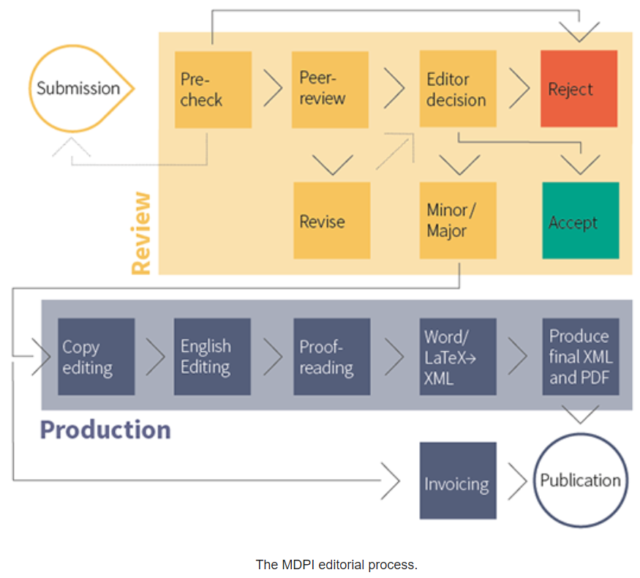
Potential and Reputable Journal?
Kualitas proses peer review
Penilaian metode dari segi validitas, signifikansi, originalitas, kejelasan secara sains
Kesimpulan sains vs spekulasi dan opini
Knowledge transfer, mempermudah peneliti membangun ide peneliti lain
Sitasi paper setelah artikel terbit (SCI, Scopus, Web of Science)
Penerbit
Proses editorial, proses publikasi, pengarsipan jangka panjang
https://thinkchecksubmit.org/
https://www.scimagojr.com/
https://www.elsevier.com/connect/predatory-vs-trustworthy-journals-what-do-they-mean-for-the-integrity-of-science

Slide 7
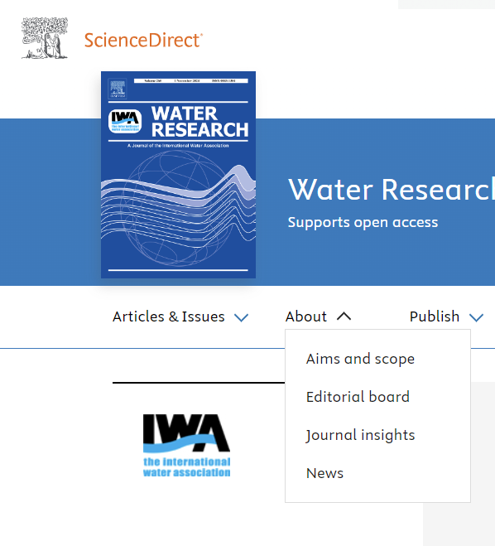
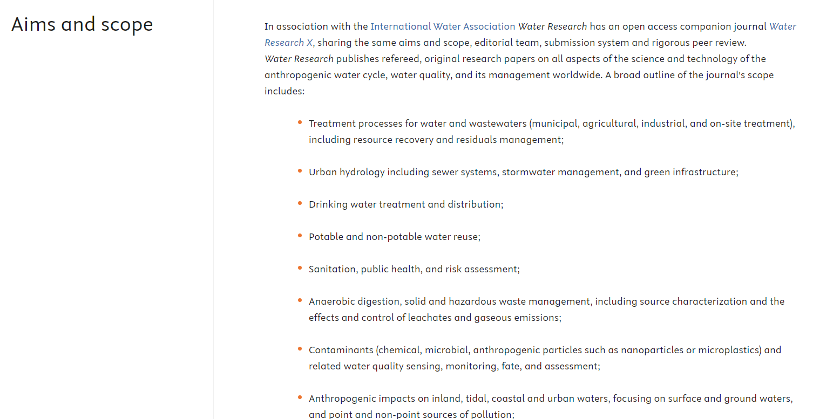
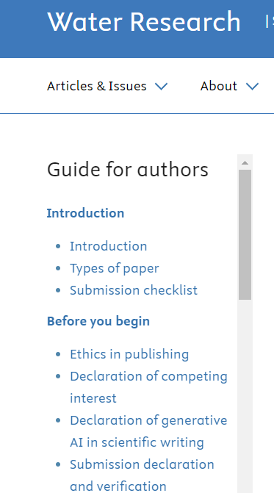
Jurnal Apa?
Cek format submission?
Page limitation
Kesesuaian riset dan tema jurnal?

Slide 8
Tips Urutan Menulis
(Study literatures of research prop.)
Figure and Tables
Methodology
Results
Discussion
Conclusions
Introduction
Abstract
Title
Keywords
Nomenclatures
Acknowledgements
References
https://www.elsevier.com/connect/11-steps-to-structuring-a-science-paper-editors-will-take-seriously

Slide 9
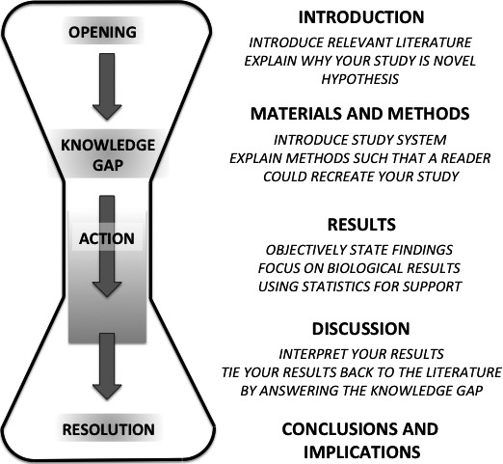
Introduction
Tidak hanya menjelaskan apa yang dilakukan dan bagaimana cara melakukannya, tetapi juga mengapa hal itu dilakukan dan mengapa hal itu penting.
Bulletin Ecologic Soc America, Volume: 97, Issue: 4, Pages: 417-426, First published: 03 October 2016, DOI: (10.1002/bes2.1258)

Slide 10
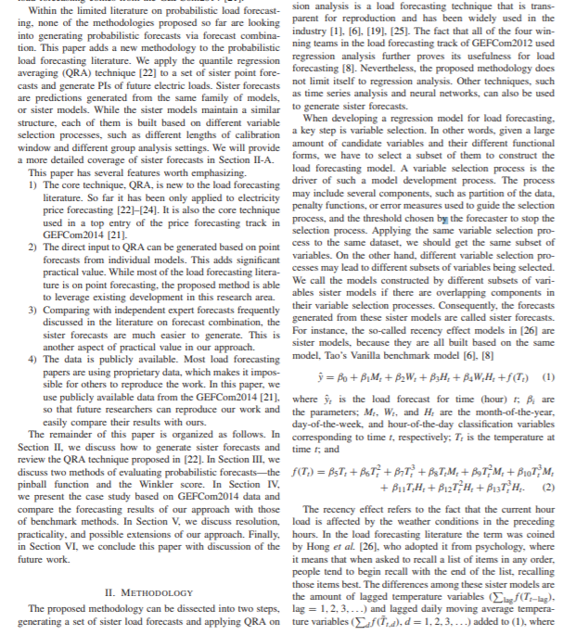
Collection of Literatures Study Summary
Ref. Title | Aim and Objective | Methodology | Discussion result | Implication
1
Manfaat:
Penggambaran permasalahan
Rumpun metodologi penelitian kita
Benchmarking metode analisa
Cara evaluasi metode (Statistical test)
Tingkat keberhasilan metode dalam mengatasi permasalahan
Mengetahui kebaharuan riset

Slide 11
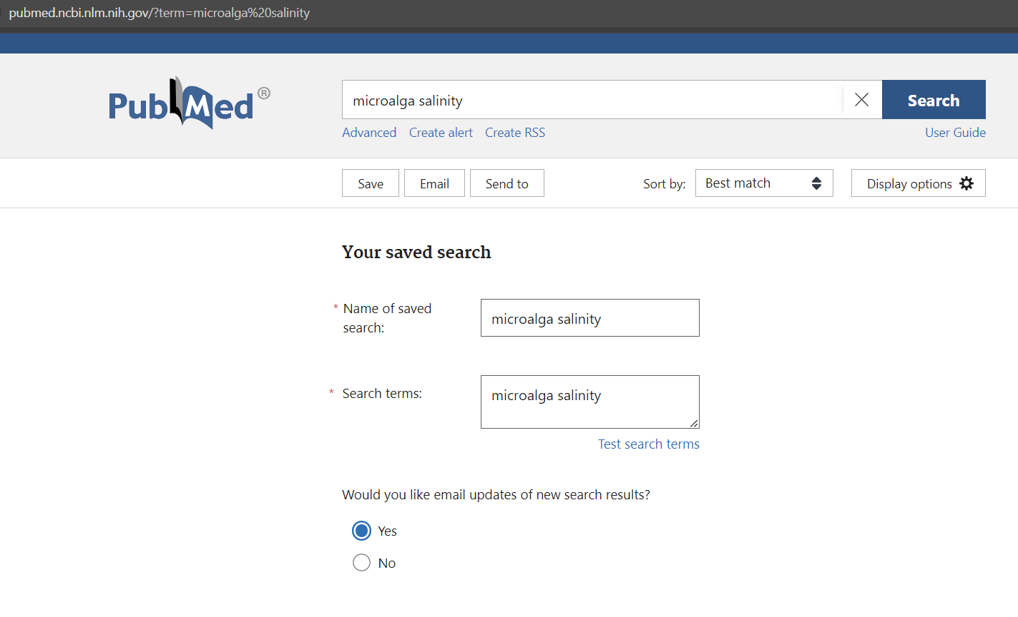
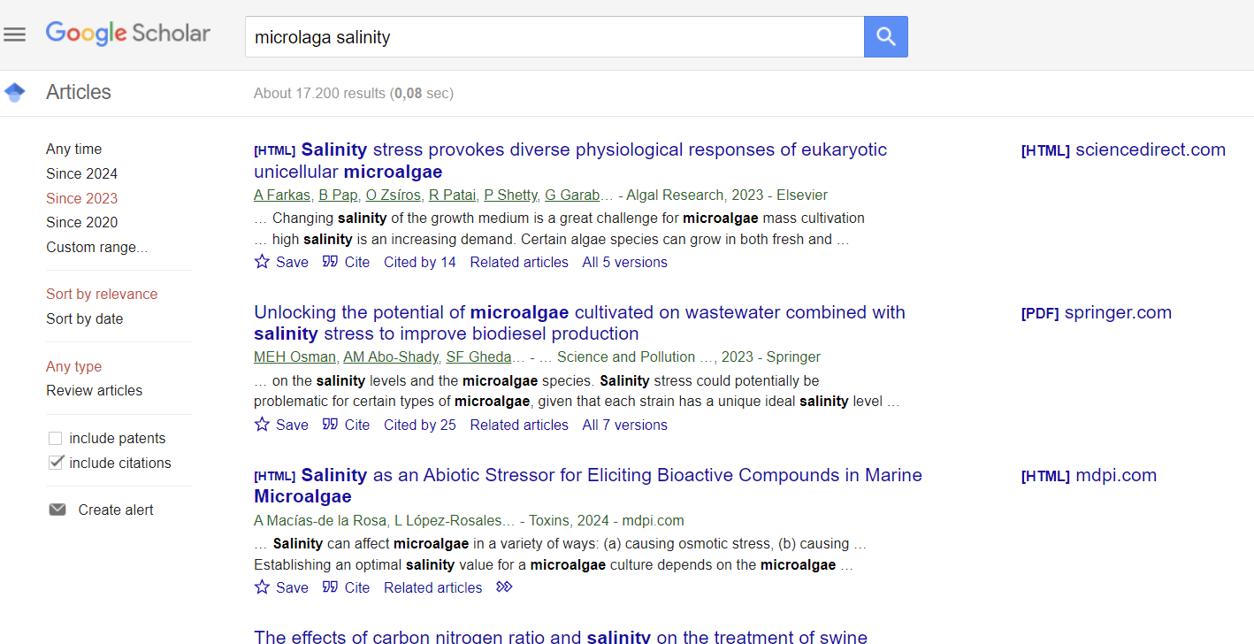

Slide 12
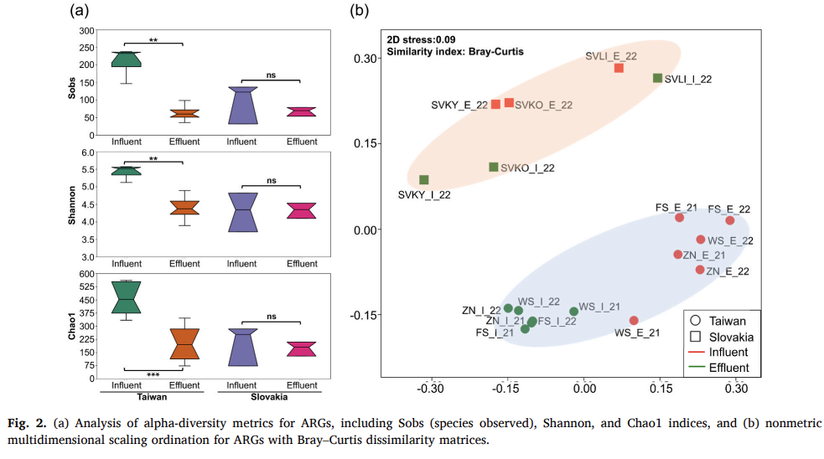
Format Gambar?
Pastikan terbaca jelas, dengan font minimal 14 (bila double column)
Variasikan warna dan pattern, sehingga bila di-print B&W, reader tetap dapat memahami tabel
Fig. 1 / Figure 1 ?
Konsisten
.bmp
.png

Slide 13
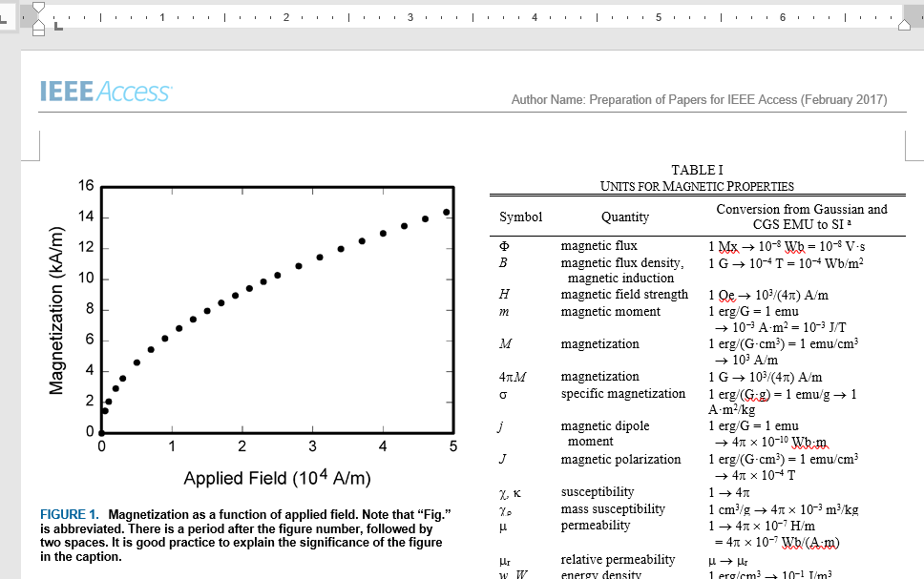
Format Table?
Pastikan table berada dalam margin artikel
Perhatikan “line type”, “caption font style”

Slide 14
Result & Discussion
Tunjukkan uji statistik yang digunakan dengan semua parameter relevan: misalnya, rata-rata dan deviasi standar (SD): 44% (±3);
Hindari ekspresi yang tidak spesifik seperti "suhu lebih tinggi", "pada tingkat yang lebih rendah", "sangat signifikan". Deskripsi kuantitatif selalu lebih disukai (masing-masing 35ºC, 0,5%, p<0,001).
Hindari pernyataan yang melampaui apa yang dapat didukung oleh hasil.
Hindari pengenalan istilah atau ide baru secara tiba-tiba;
Spekulasi tentang kemungkinan interpretasi diperbolehkan, tetapi ini harus didasarkan pada fakta, bukan imajinasi.

Slide 15
Judul Manuscript
Buatlah judul yang ringkas dan deskriptif
Judul: Preliminary observations on the effect of salinity on benthic community distribution within an estuarine system, in Lombok.
Revisi Judul: Effect of salinity on benthic distribution within the Tanjung Karang estuary, Ampenan Lombok.
Judul: Action of antibiotics on bacteria
Revisi Judul: Inhibition of growth of Mycobacterium tuberculosis by streptomycin

Slide 16
Teks atau Graphical Abstract?
Perhatikan words limit…
Background, real world problem to solve
How the proposed method work
How we validate the proposed method and the data used to validate the proposed method
What is the results and implication of the proposed method.
This study presents a comprehensive analysis of samples from urban wastewater treatment plants using anoxic/oxic processes in Slovakia and Taiwan, focusing on microbiome, resistome, mobilome, and virulome, which were analyzed using a shotgun metagenomic approach. Distinct characteristics were observed; in Taiwan, a higher abundance and diversity of antibiotic resistance genes were found in both influent and effluent samples, while there was a higher prevalence of mobile genetic elements and virulence factor genes in Slovakia. Variations were noted in microbial community structures; influent samples in Taiwan were reflected from fecal and hospital sources, and those in Slovakia were derived from environmental elements. At the genus level, the samples from Taiwan’s sewage treatment plants were dominated by Cloacibacterium and Bacteroides, while Acinetobacter was predominant in samples from Slovakia. Despite similar antibiotic usage patterns, distinct wastewater characteristics and operational disparities influenced microbiome, resistome, mobilome, and virulome compositions, with limited reduction of most resistance genes by the studied anoxic/oxic processes. These findings underscore the importance of region-specific insights into microbial communities for understanding the dynamics of antimicrobial resistance and pathogenicity in urban wastewater treatment systems. Such insights may lay the groundwork for optimizing treatment processes and reducing the dissemination of antibiotic resistance and pathogenicity genes for safeguarding public health.

Slide 17
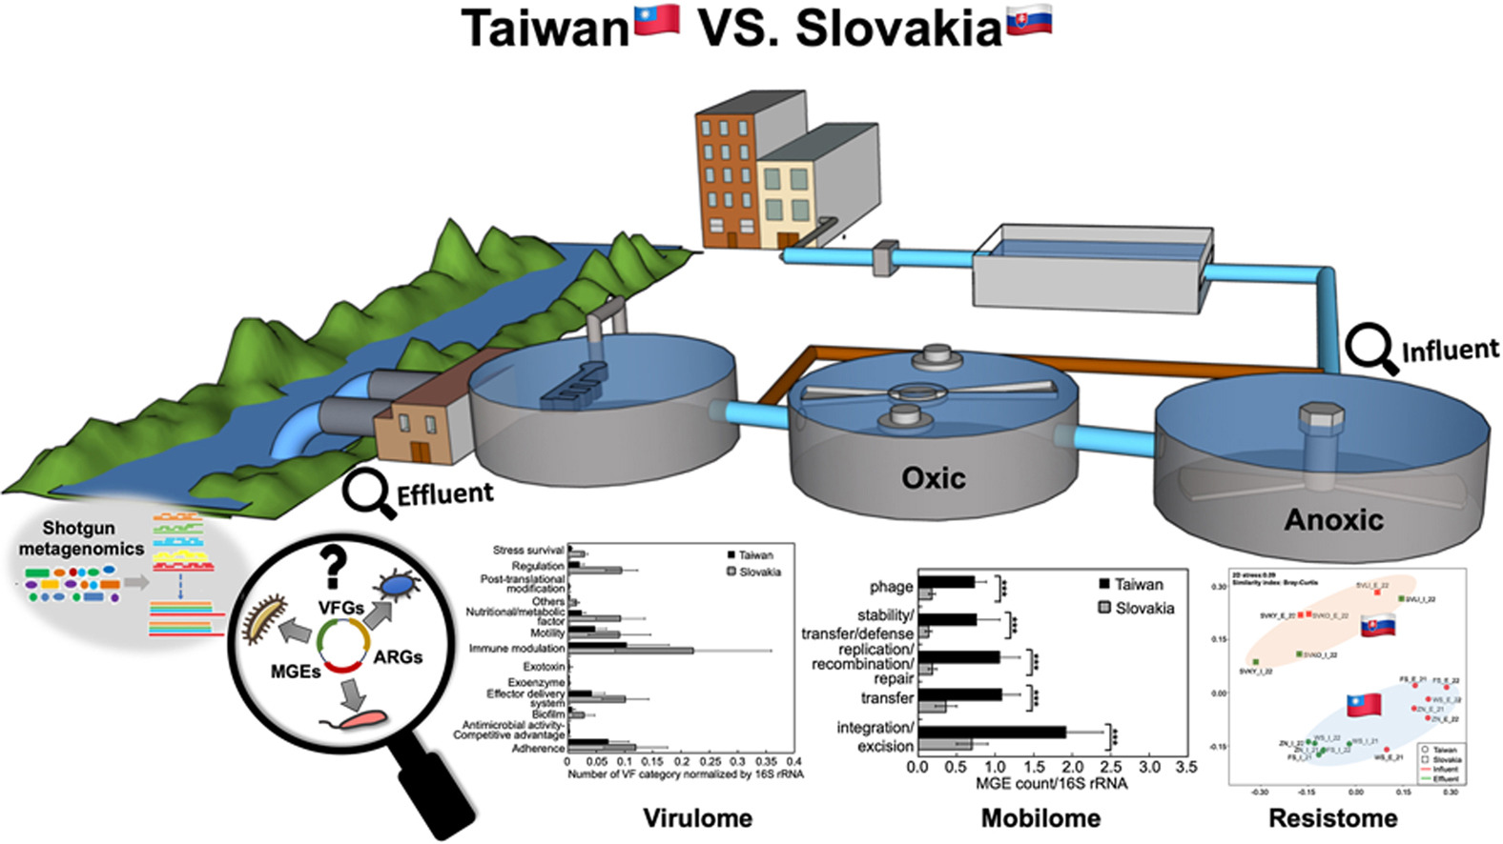
Teks atau Graphical Abstract?
Reader dapat mengerti komponen abstract hanya dengan melihat graphical abstract

Slide 18
References
Usahakan sitasi diambil dari jurnal yg dituju, reputable, Q1, hindari mengambil conference sebagai reference
> 40 references
Perhatikan punctuation dan format penulisan secara teliti sesuai template jurnal
Science Direct – Water Research
[1] Naufal, M., & Wu, J. H., 2020. Stability of microbial functionality in anammox sludge adaptation to various salt concentrations and different salt-adding steps. Environ. Pollut. 264, 114713. doi:10.1016/j.envpol.2020.114713
[2] Naufal, M.; Wu, J. H., Stability of microbial functionality in anammox sludge adaptation to
various salt concentrations and different salt-adding steps. Environ. Pollut. 2020, 264, 114713.
ACS
Environmental Science &Technology

Slide 19
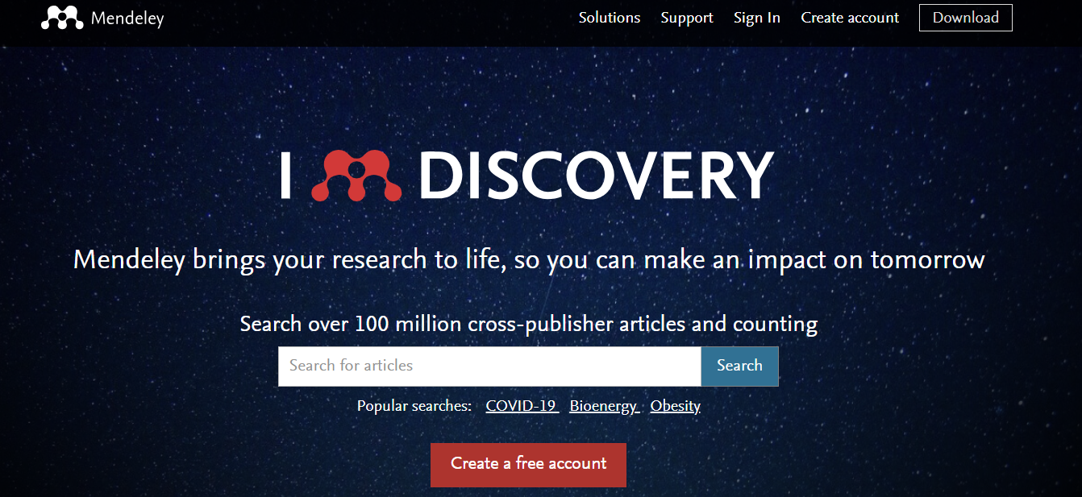
Software Pendukung?
Mendeley
Grammarly
Endnote

Slide 20
Checklist Sebelum Manuskrip Final
No typo
No grammar error
Format penulisan reference sudah benar?
Semua reference di manuskrip urut?
Word & Page limitation aman?
Print manuscript, cek apakah semua figure terbaca jelas?

Slide 21
Sebelum Submit
Final manuscript
Abstract
Cover Letter
Tentukan corresponding author
Biasanya dipilih yang paling expert dan banyak sitasinya
Keywords

Slide 22
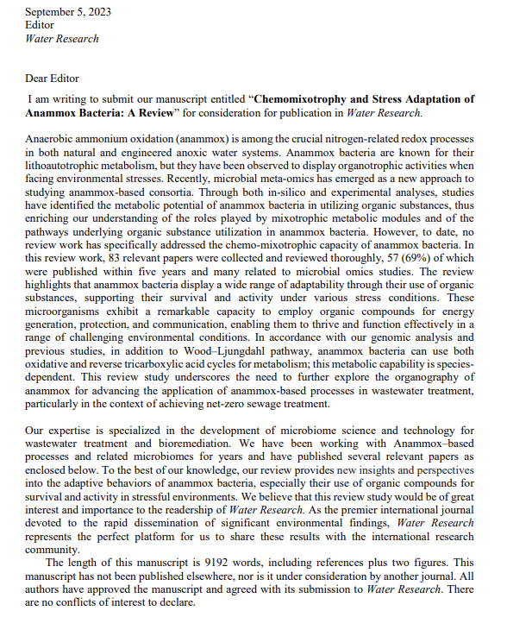
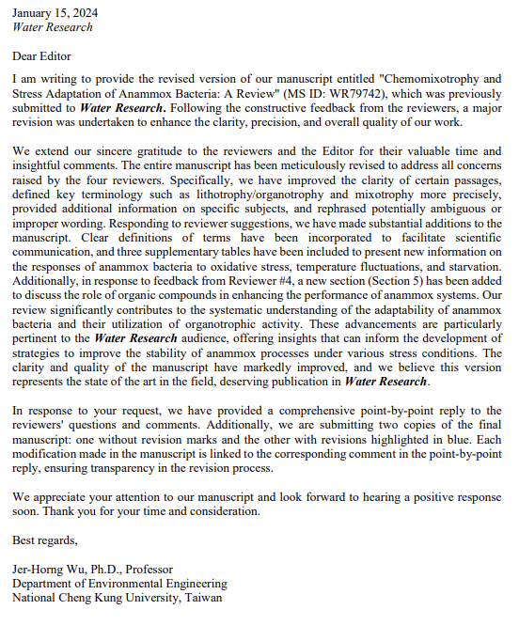
Cover Letter

Slide 23
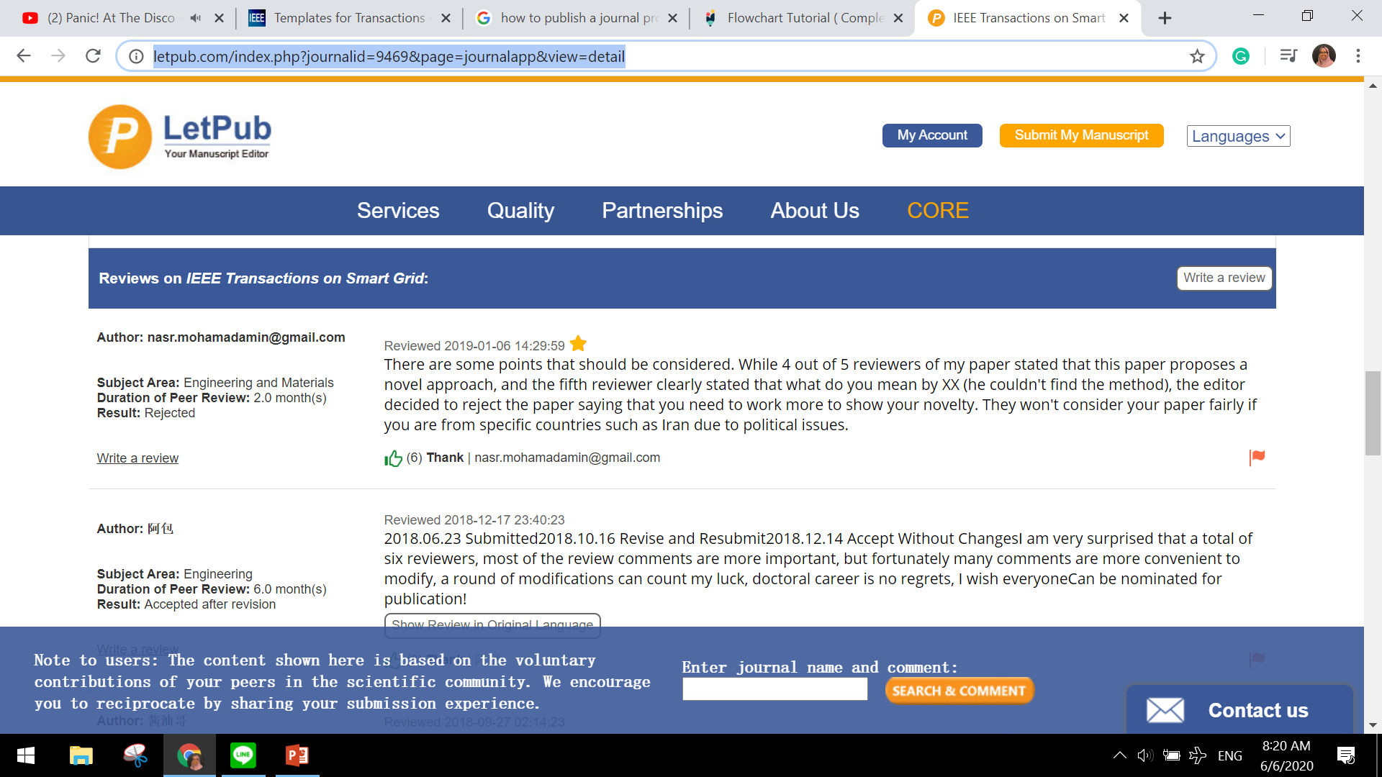
Setelah Submit
Review Process butuh waktu sebelum paper dinyatakan ACCEPTED/MINOR REVISION/MAJOR/REJECTED…
Untuk open access journal +/- 2 minggu decision, 2 bulan published
Untuk journal biasa, +/- 3 bulan decision, 1 tahun published

Slide 24
For Your Information…
Makalah yang baik harus:
Menyajikan metode analisis atau eksperimen baru.
Menyajikan proses, desain, atau teknologi baru.
Membahas dan memberikan pemikiran segar tentang dampak pada kebijakan publik dan lingkungan yang terus berkembang.
Ditulis dalam bahasa yang jelas dan mudah dipahami.
Menarik bagi pembaca jurnal.
Bermanfaat bagi profesi dalam jangka panjang
Makalah yang tidak baik :
Menjiplak atau mengulang pemikiran lama yang sudah terbukti.
Ditulis dengan memaparkan ide yang sama atau serupa di jurnal atau prosiding lain.
Menyalin ide orang lain tanpa sitasi yang tepat.
Ditulis dengan buruk, atau ditulis dengan cara yang tidak jelas
https://www.ieee-pes.org/part-8-reviewer-and-editor-guidelines

Slide 25
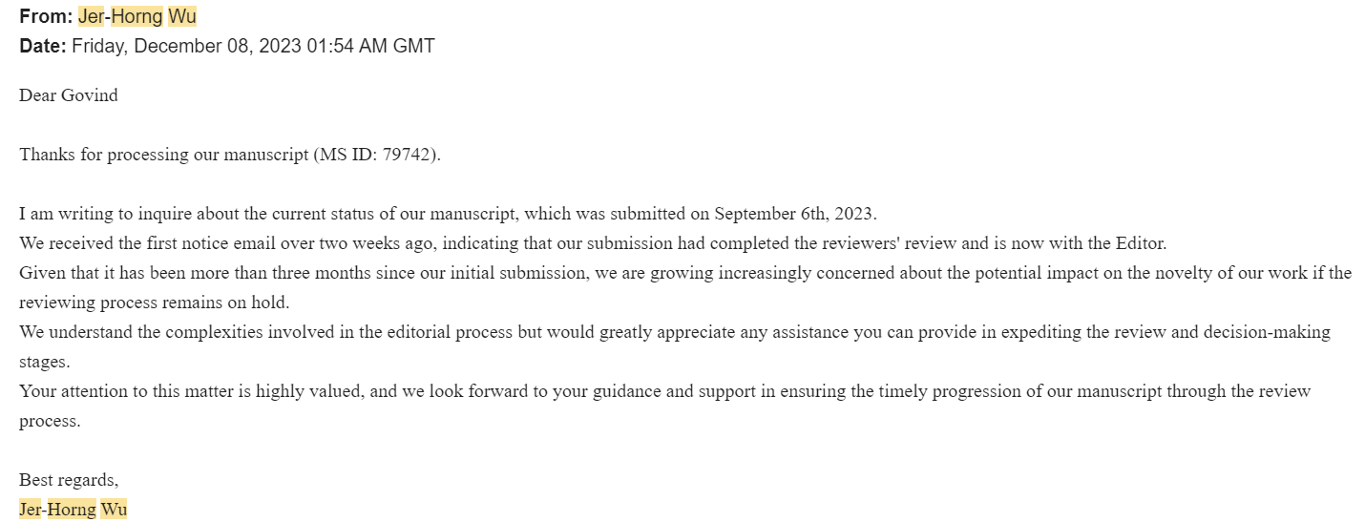
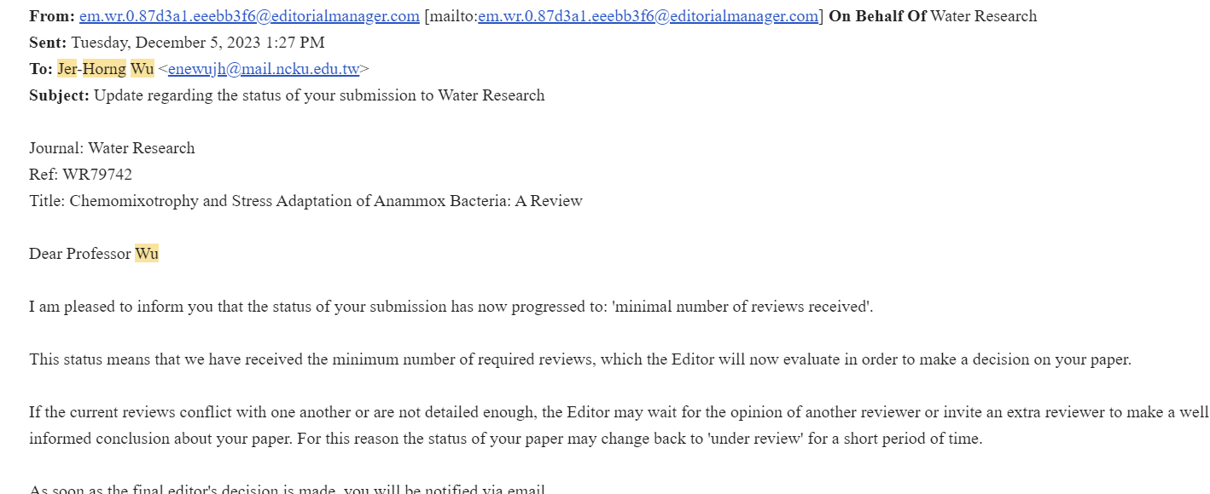
During Submission

Slide 26
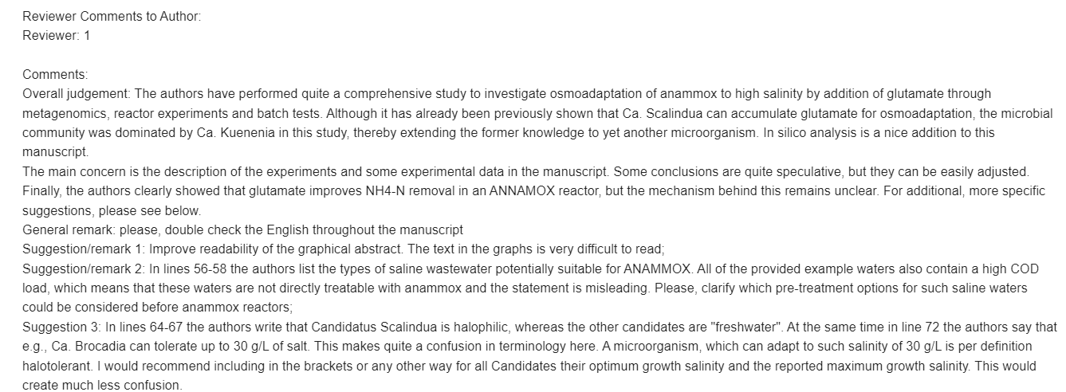
During Submission

Slide 27
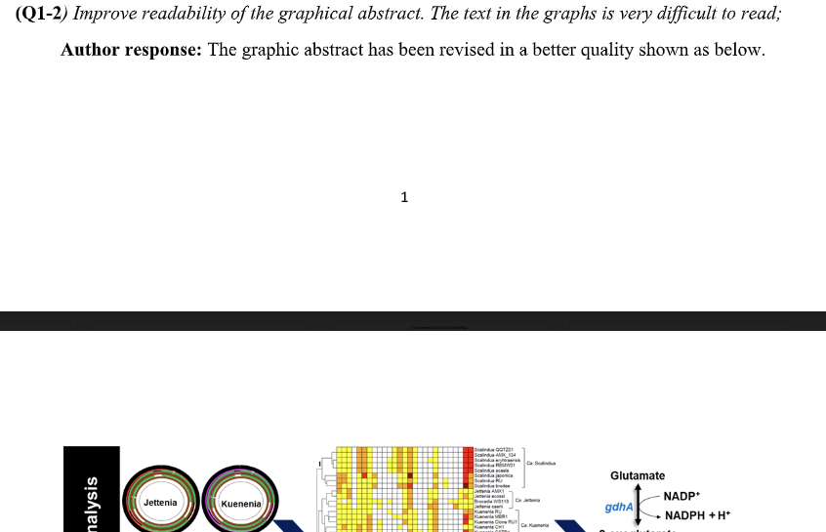
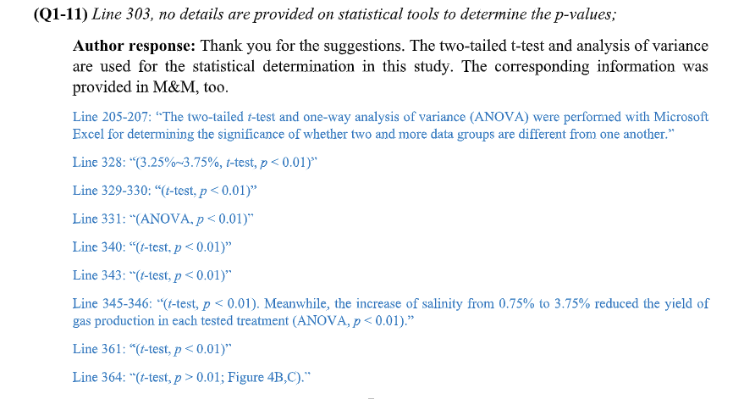
During Submission

Slide 28
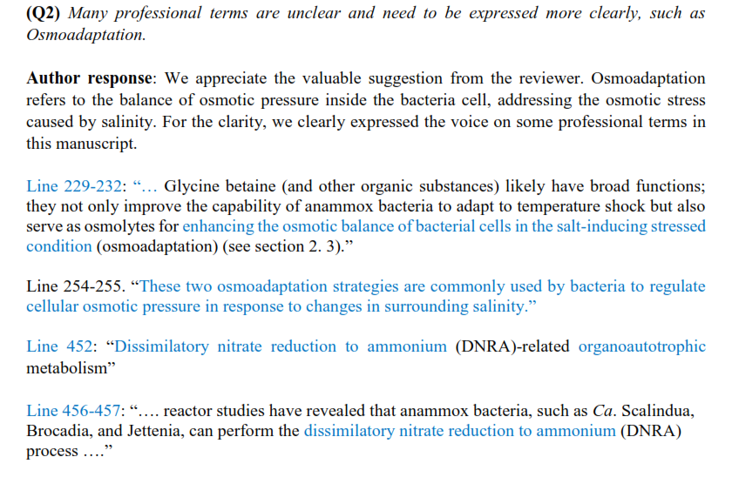
During Submission

Slide 29
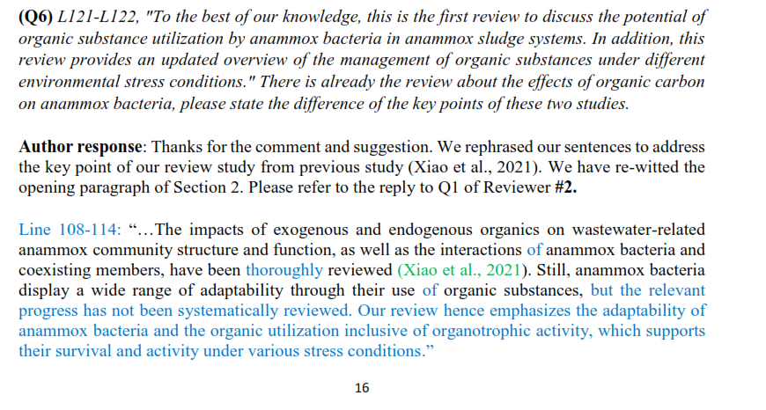
During Submission

Slide 30
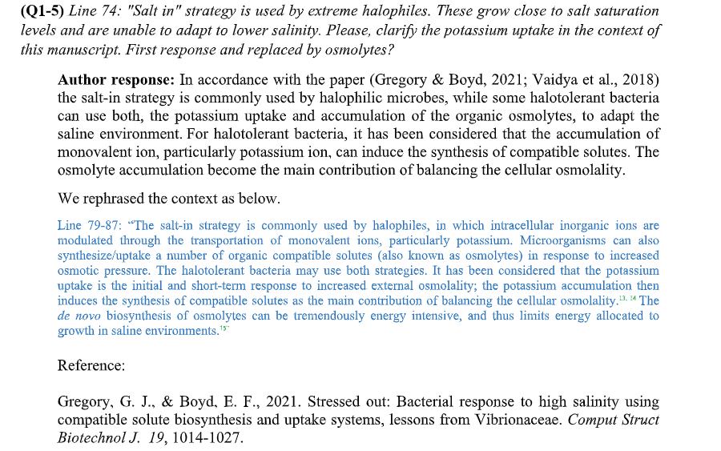
During Submission

Slide 31
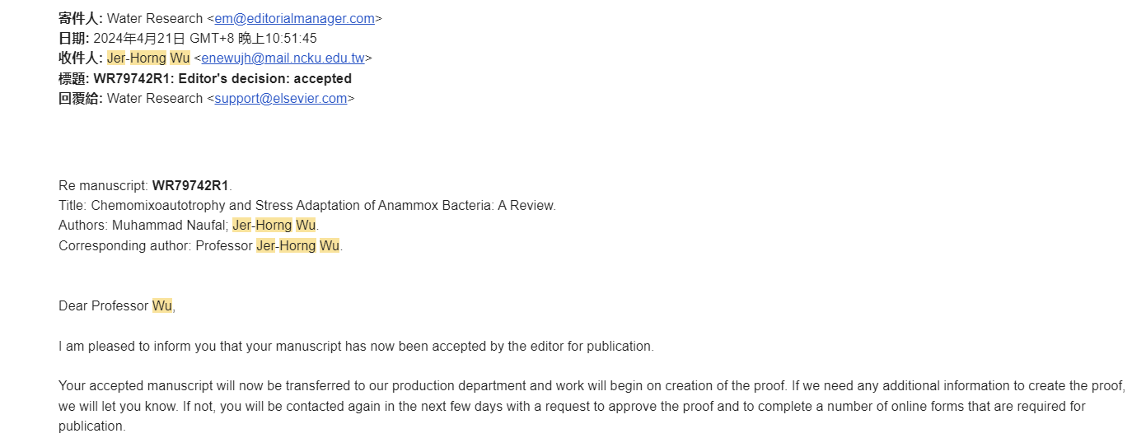
During Submission

Slide 32
Don’t take reviewer’s comments personally
Aim for the highest reputable journal,
Though it is rejected at first,
it will be our guide to improve our manuscript
It will be accepted very soon
Work twice smarter and
List what reviewer’s want!
Q1 journal is difficult,
but worth to try

Slide 33
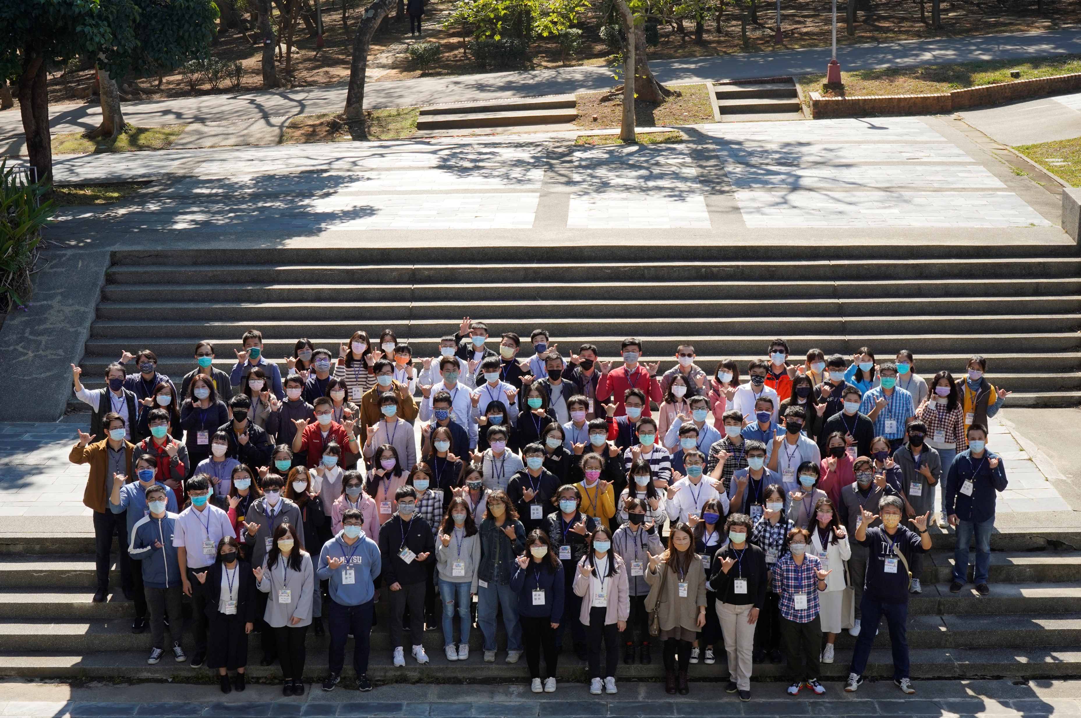
Q&A Session
muha353@brin.go.id

Slide 34
Thank You
muha353@brin.go.id

Slide 36
Publish An Article In A Reputable International Journal

